Slide 1
Persona and Mood Board Team Azure
By Sangam, Yohanna, and Damien
Professor Andy Cameron – CSC 3220

Slide 2


Persona
BIO
David owns and manages a busy local pizzeria in Leavenworth. He handles inventory, supplier orders, staff, and daily sales. Because he tracks stock manually, he often runs out of ingredients or overorders, which costs time and money. He prefers simple, fast tools that help him make smarter purchasing decisions without interrupting his workflow.
DAVID HENDERSON
NEEDS & GOALS:
AGE
34
An easier/simpler way to track their products (Low Stock, Overstock, Understocking, etc.)
Centralized inventory management system.
A system that tracks sales.
OCCUPATION
Pizzeria Owner
LOCATION
Leavenworth, WA
TECH COMFORT LEVEL
Moderate
WHAT PROBLEM DOES THE APP SOLVE?
PAIN & FRUSTRATIONS:
Gives her real-time visibility into current inventory levels
Sends low-stock alerts before she runs out of ingredients
Tracks sales patterns so she can plan orders with confidence
Recommends when and how much to reorder
Automatically updates inventory whenever a sale is made
Running out of key ingredients during busy hours
Ordering too much stock and losing money to food waste
Spending too much time counting inventory manually
Still not knowing the exact stock levels after checking
Having no warning when items are about to run low

Slide 3
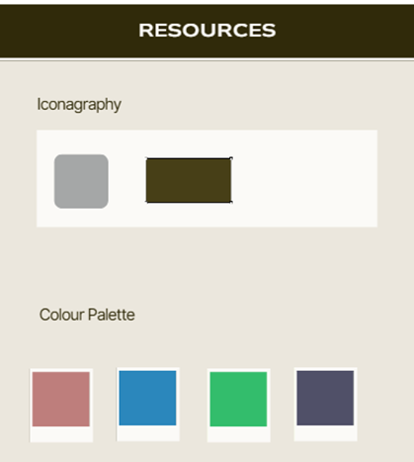
Iconography, Color Palette & Typography
Heading: StockPilot (Montserrat) Body: Home (Open Sans)

Slide 4
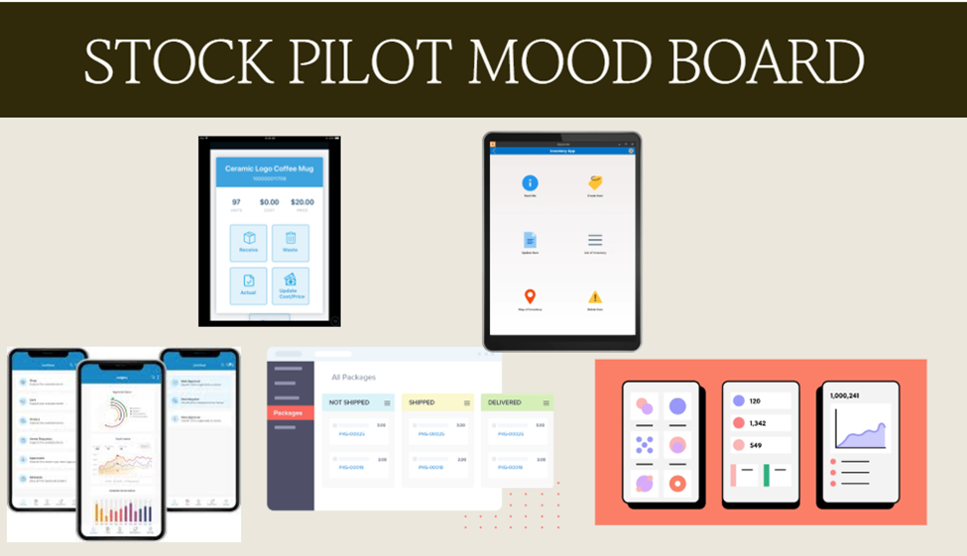
Mood board

Slide 5
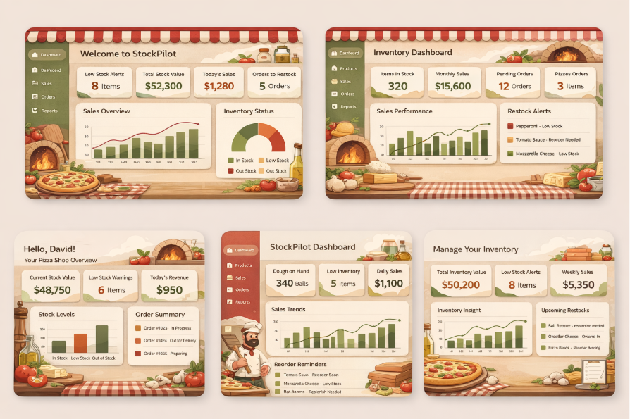
Images
Generated by A.I

Slide 6

Thank you!
Questions

